Slide 1
For Live Session Assignment (FLS)
Unit 7

Slide 2
Quick Quiz Questions

Slide 3
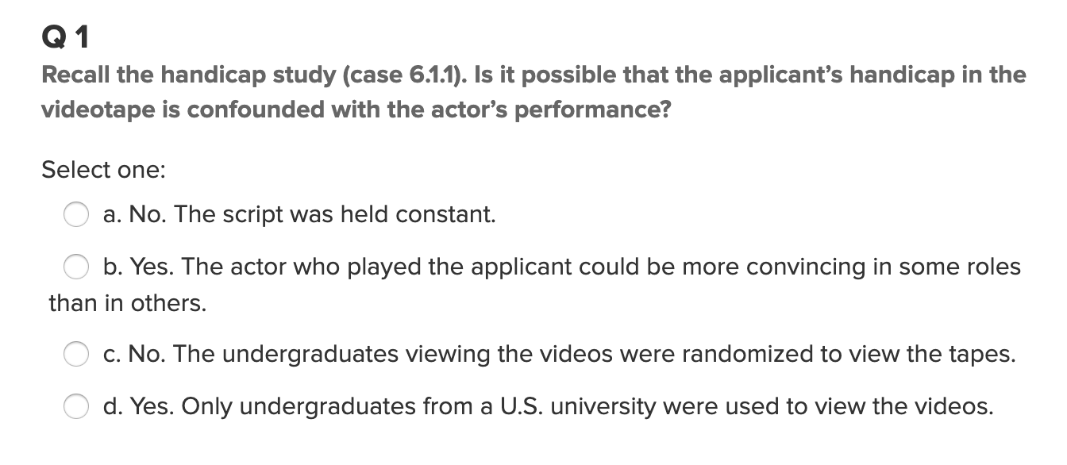
Question 1

Slide 4
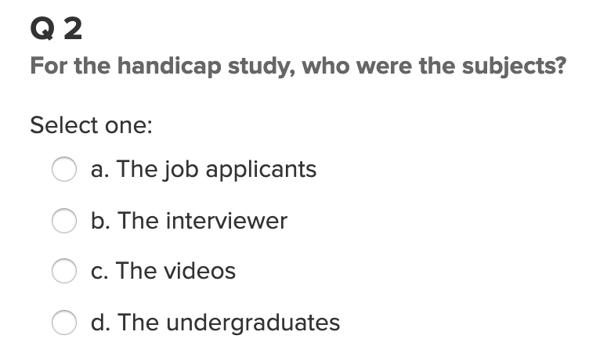
Question 2

Slide 5
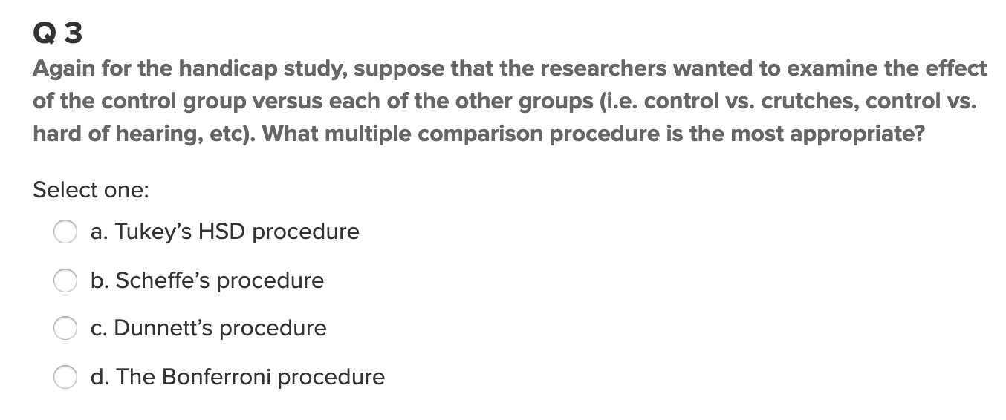
Question 3

Slide 6
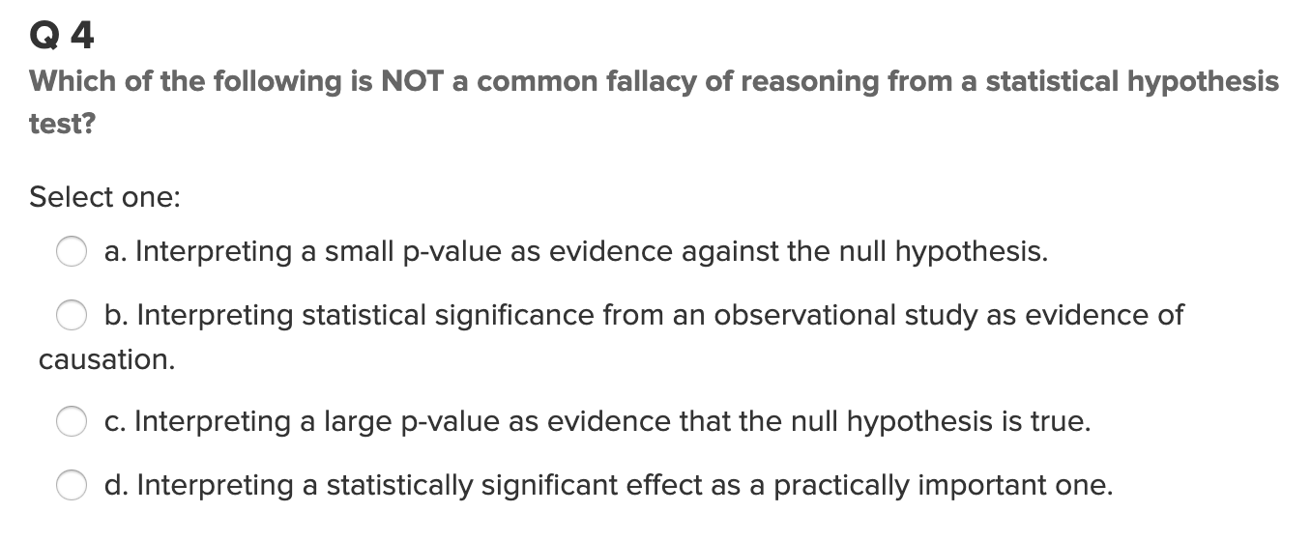
Question 4

Slide 7
End Quick Quiz Questions

Slide 8
Question 1: Height Example Contrast

Slide 9

Question 1: Height Example Contrast $≤$1 Hour

Slide 10
Contrasts
We found in the last Unit that there was overwhelming evidence that at least one pair of sports had different mean heights. We ran the extra sum of squares test to find if there was significant evidence to suggest that the mean height of basketball players was different than that of the other sports. Another method to test for this difference is with a contrast. Create a contrast to test to see if there is evidence that that mean height of basketball players is significantly different than the average of the mean heights of the other 4 sports.
Your response should be neat, organized and thorough. Please include the code you used to generate your results as well as a conclusion statement that is written in non technical terms (but include the pvalue and a confidence interval).

Slide 11

Question 2: Height Example Multiple Comparison $≤$1 Hour

Slide 12
Multiple Comparisons: Break Out
We found in the last Unit that there was overwhelming evidence that at least one pair of sports had different mean heights. We ran the extra sum of squares test to find if there was significant evidence to suggest that the mean height of basketball players was different than that of the other sports. This time, let’s run every pairwise t-test and perform the appropriate multiple comparison adjustment and see if these results agree with the extra sum of squares test!

Slide 13

Question 3: HW Problem $≤$1 Hour

Slide 14
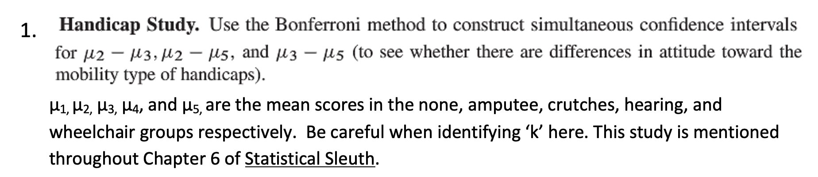
HW Problem

Slide 15
Question 4: Takeaways!
Please provide at least 4 takeaways from this section and any questions that you may have. These questions will help design the live session for this unit.
This question will be the last question of every For Live Session Assignment. The idea is that this deck will serve as a document that you can reference in the future to remember what was covered in this section. For instance, this may come in handy for the Capstone and will hopefully become useful in your career. Most immediately, it may become handy as a quick reference for your Midterm and Final! Some students find it very useful and spend a few slides summarizing the asynch material while others learn different ways and only had the minimum 4 takeaways. Either is fine and will earn you full credit for this question.

Slide 16
Question 5: Questions!
Please provide any question or topics of discussion that came up in this Unit! These will help help us optimize our live session for maximum learning and takeaways!
This question will be the last question of every For Live Session Assignment. The idea is that this deck will serve as a document that you can reference in the future to remember what was covered in this section. For instance, this may come in handy for the Capstone and will hopefully become useful in your career. Most immediately, it may become handy as a quick reference for your Midterm and Final! Some students find it very useful and spend a few slides summarizing the asynch material while others learn different ways and only had the minimum 4 takeaways. Either is fine and will earn you full credit for this question.

Slide 17
End For Live Session Assignment Unit 7!

